Slide 1
Managing Extracts

Slide 2

Managing Extracts - What?
What is Tableau’s Extract?
A Special type of database, optimized for use by Tableau. It is super fast, portable and a great way to handle large data sets

Slide 3
Managing Extracts - Why?
Increased Performance
Data extraction not only offers increased performance when the underlying data source is unacceptably slow
but it also can speed up the performance when the use of CustomSQL slows it down
Reduced load
Tableau Data Extract (TDE) reduces the load on the database that could result heavy Tableau user traffic
Working Offline
A TDE can be used for working on with static copy of the data
Publishing to Tableau Public and Tableau Online
Tableau Public only supports TDEs. While Tableau Online can connect live to cloud-based data sources, TDEs are the most common data source used in that environment

Slide 4
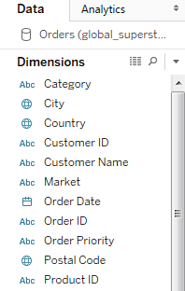
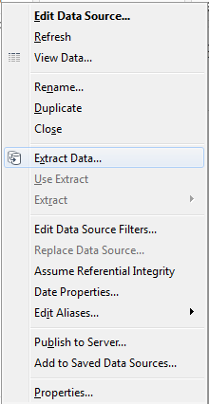
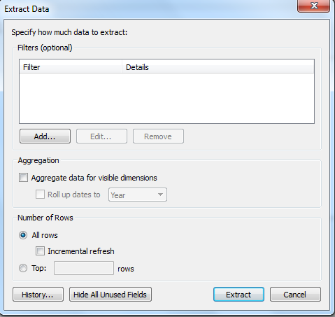
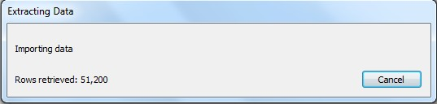



Managing Extracts - How ?

Slide 5
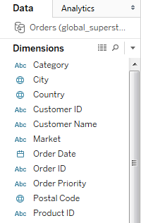
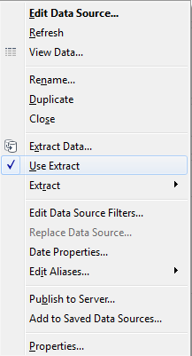
Managing Extracts - How ? contd…
Note: For working on with live dataset again just uncheck the ‘Use Extract’ option

Slide 6

M eta Data

Slide 7


Understanding MetaData
Real Data
(Earth)
Physical Appearance of earth
Meta Data
(political globe with information about earth)
Latitudes, Longitudes, States-Name, Ocean Name

Slide 8


MetaData Contd…
Meta Data
Name of the Book
Author of the Book
Publisher of the Book
Price of the Book
ISBN
Page numbers

Slide 9
MetaData in BI
Metadata is defined as “data about data”
Metadata describes the context, use, and validity of business information
Common metadata attributes include the date and time that data was collected or changed, and the data source or identification of the person who performed the change
Metadata attributes for an electronic document or record may include the type of record, its retention period,
and its security classification or category

Slide 10
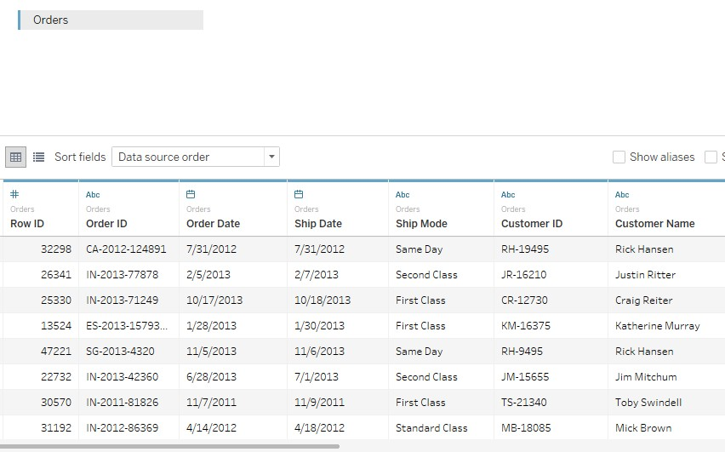
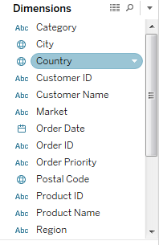
Data and MetaData in Tableau
Real Data
Metadata in Tableau

Slide 11
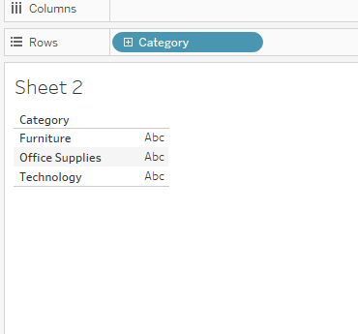
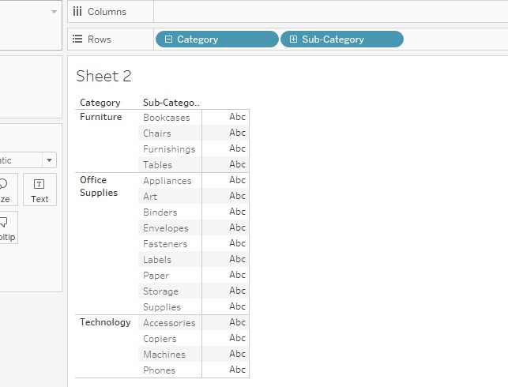


Managing MetaData-Hierarchy Example

Slide 12
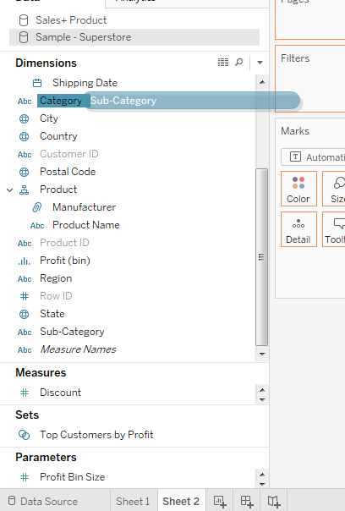
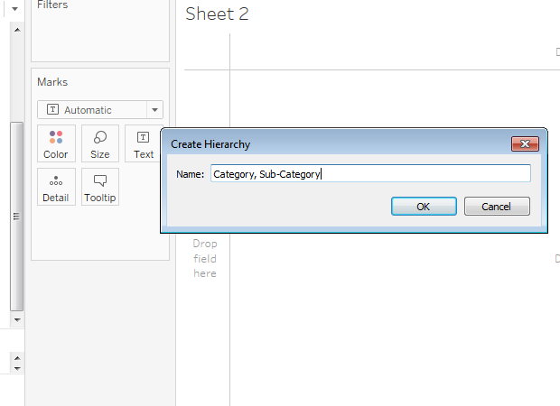
Managing MetaData-Creating Hierarchy
We can create hierarchy just by dragging an attribute and placing it over other

Slide 13
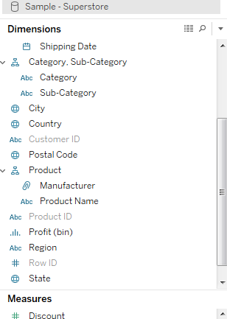
Hierarchy Created
A new Hierarchy is created “ Category, Sub-Category ”

Slide 14
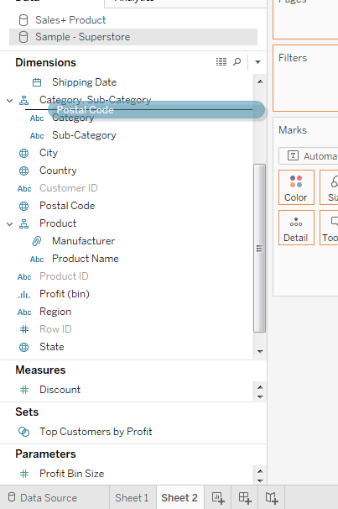
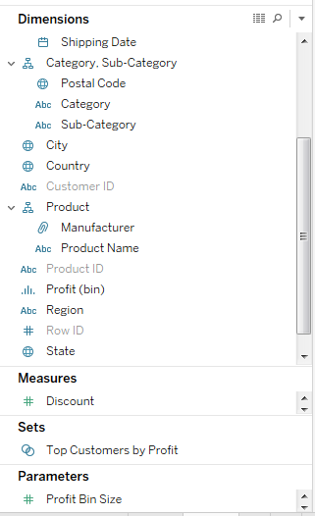

Adding Extra Field to Hierarchy
1
2 result
You can always add an extra fields to
the hierarchy just by drag and drop

Slide 15
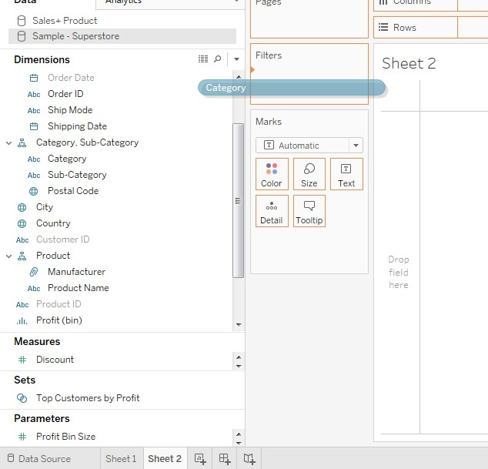
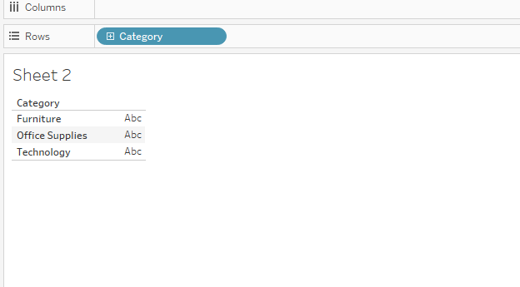
Hierarchy View
Drag and Drop Category to the Row
2
1

Slide 16
Managing MetaData-Hierarchy Example
1
Click this to view hierarchy,
This is known as “ Drill Down ” Feature
2
Ability to drill down in the
view (Hierarchical results )
3

Slide 17
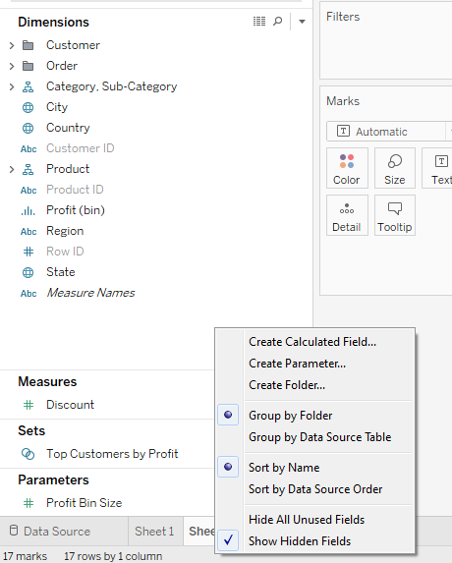
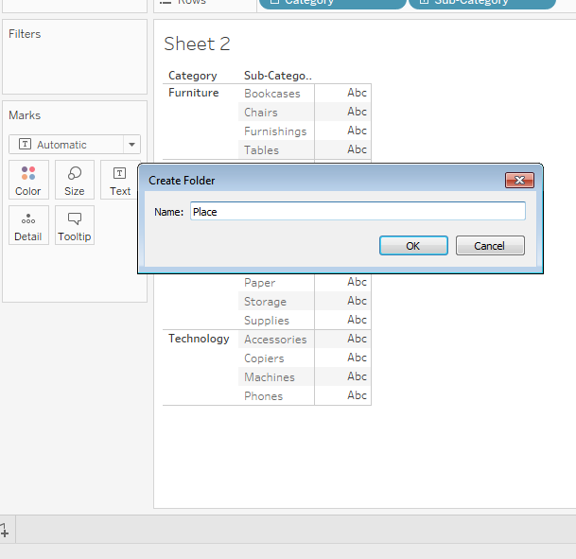
Managing MetaData-Creating Folders

Slide 18
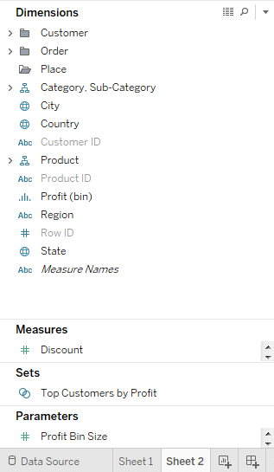
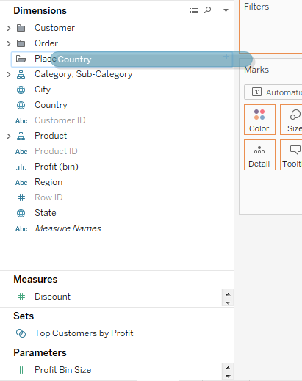
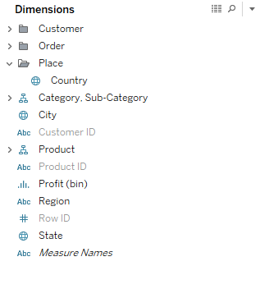
Managing MetaData-Creating Folders
1
Place Folder created, now drag attributes in it
3 result

Slide 19
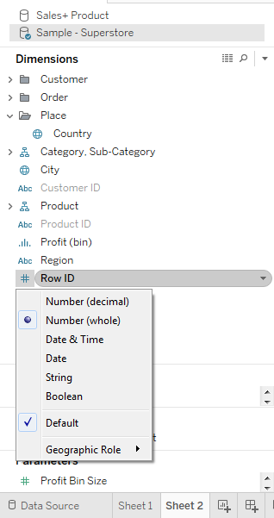
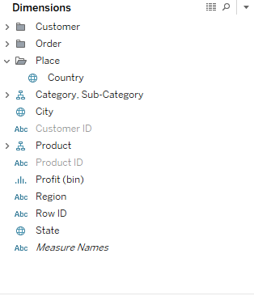

Managing MetaData-Changing Data Types
1
Right Click on this icon and select the
data type for Row ID
2
Here we changed the data type to String.
Note: If you change the data type(for ex) of OrderID from String to Date Value, it
would give a vague result

Slide 20




Waaoo!! That was damn interesting
I just hope next topic is as interesting as previous one

Slide 21


